Slide 1
Best Practices for Cloud Spend
How to maximize your cloud spend
Kam Amir
May 2020

Slide 2
Table of Contents
This list will grow
Determine your Spend
Location, Location, Location
See spot run
Service bloat

Slide 3
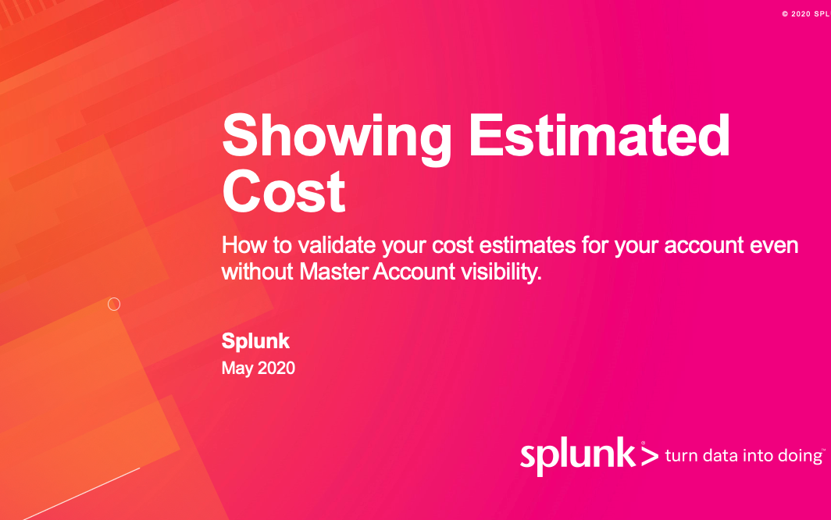
Check out this deck first to see how to setup CloudWatch Metrics to view your estimated spend

Slide 4
Location, location, location
Reduce your spend by changing regions
Assuming
C5.2XL x 1 (shared host)
100GB GP2 EBS Volume
100% Utilized
Linux
On-Demand Savings Using US East 1 instead of :
US West 1 : $61.49
EU West 1 : $35.14
AP SE 2 : $76.13
SA East 1 : $134.69
 | US East 1 | US West 1 | EU West 1 | AP Southest 2 | Sa-east-1
On Demand | $248.88 | $310.37 | $284.02 | $325.01 | $383.57
Reserved* | $156.22 | $194.91 | $178.12 | $204.40 | $240.90
Savings | $92.66 | $115.46 | $105.90 | $120.61 | $142.67
* Reserved 1 Year no upfront contract

Slide 5
See spot, see spot run
Reduce your spend by changing instance types
Assuming
C5.2XL x 1 (shared host)
100GB GP2 EBS Volume
100% Utilized
Linux
Spot Savings Using US East 1 instead of :
US West 1 : $65.70
EU West 1 : $43.80
AP SE 2 : $94.90
SA East 1 : $131.40
 | US East 1 | US West 1 | EU West 1 | AP Southest 2 | Sa-east-1
On Demand | $0.34/hr | $0.42/hr | $0.39/hr | $0.44/hr | $0.52/hr
Spot | $0.17/hr | $0.16/hr | $0.16/hr | $0.14/hr | $0.17/hr
Savings | $124.10 | $189.80 | $1167.90 | $219.00 | $255.50

Slide 6
Service bloat
Watch out for these services
Service | Cost | Number of calls
CloudWatch (metrics)
CloudWatch (logs)
CloudTrail
S3
EBS
Snapshots
EC2

Slide 7
Thanks

